Slide 1



Newton School
Capstone
Project
Analytical CRM
Development for a Bank
Presented by:
Kumara Swamy Kongari

Slide 2

INTRODUCTION
Today, we'll explore the customer relationship management analysis for our bank, focusing on different geographic locations. This report highlights key insights and trends to enhance our customer interactions and satisfaction across all regions.

Slide 3

Problem Statement
As a CRM (Customer Relationship Management) specialist hired by a bank to extract meaningful insights from various customer-related datasets. The bank aims to reduce customer churn, improve service delivery, and enhance customer satisfaction. They have provided you with datasets including customer demographics, transaction details, customer exit information, and active customer profiles.

Slide 4
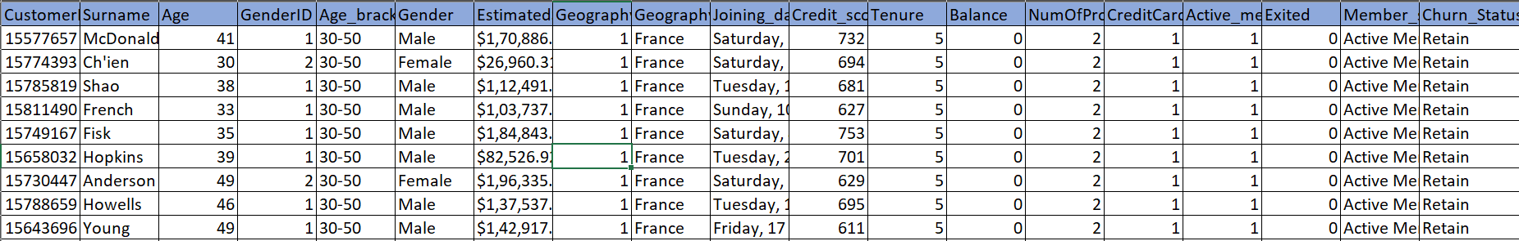
Tools and Approach
The dataset is in 7 different Excel files explaining geographic locations, bank_churn, gender, active customer details, etc.
I have used the Power Query Editor to merge all Excel files into one file using Append and Merge.
Structured Query Language (SQL) was used to perform data extraction, transformation, and analysis. SQL queries were written to manipulate and analyze the data efficiently.
Please refer to the snippet of the merged dataset given below.

Slide 5



Geographic Locations
1.FRANCE - 5014
France is the region which has highest customers
2.GERMANY- 2509
Germany is the region which has second largest
customers
3.SPAIN- 2477
Spain is the region having smallest count of customers

Slide 6
Gender Distribution
Active MALE-2867
Active FEMALE-2284
Age group:
18-30:There are 1641 customers belong to 18-30
30-50:There are 7098 customers belong to 30-50
which consist of highest customer count.
50+:There are 1261 customers above 50.

Slide 7
CREDIT CARD HOLDERS
Credit card Holders
There are 7055 Customers having credit cards.
RETAIN
EXIT
There are 5631 customer
retained in the bank
There are 1424 customers exits the bank.
ACTIVE
NOT ACTIVE
ACTIVE
NOT ACTIVE
3125 customers
2506 customers
482 customers
942 customers

Slide 8
CREDIT SCORE WORTHINESS
CREDIT SCORE RANGE | CREDIT WORTHINESS | CUSTOMER COUNT
300-579 | POOR | 520
580-669 | FAIR | 685
670-739 | GOOD | 452
740-799 | VERY GOOD | 252
800-855 | EXCELLENT | 128

Slide 9

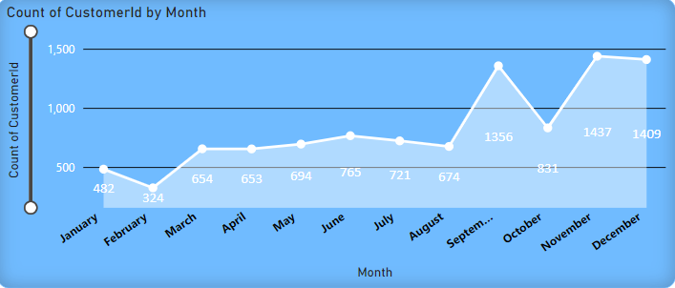
Churn Analysis
From this chart, We can understand that end of every year has highest rate of churn
And also, In the month January and February there seems to be lesser churn.

Slide 10
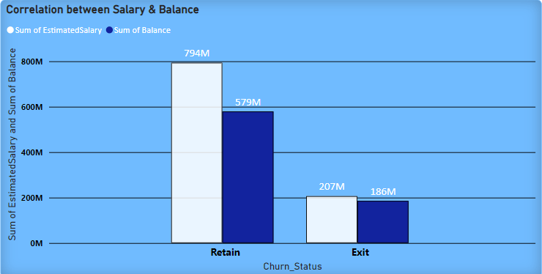
CAUSE
From this chart, We get to know that the customers who is having low salary and having low balance plan to leave the bank.

Slide 11

SOLUTION
Tenure
By increasing the tenure period for the customers who is having low salary, Customers could able to stay in the bank.

Slide 12
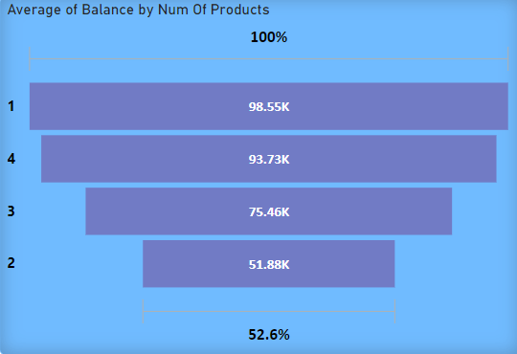
ANOTHER CAUSE
The person who are buying 4 products or 1 products are exiting the bank.
The person who are having 2 products likely to retained in the bank.
This could be resolved by offering a way that the customers who buys products should buy Minimum of 1 product and also maximum of 4 products

Slide 13
YEAR WISE EXIT COUNT
2019
2018
We are facing highest churn rate as 658 accounts
in the current year
In the year 2018, 524 accounts have been churned
2017
2016
479 accounts are exited
376 customers have exited in the year 2016

Slide 14
99086.13
YEAR 2019 AVERAGE ESTIMATED SALARY
From the above two slide, we can identify that there is dip in average salary of customers from the year 2017 to 2019. With the correlation of decreasing average salary, the churn rate seems to be increasing.
100970.14
YEAR 2018 AVERAGE ESTIMATED SALARY
101912.67
YEAR 2017 AVERAGE ESTIMATED SALARY

Slide 15
Observations:
Yearly Churn Rates:
2016: 19%
2017: 22% (Peak Year)
2018 & 2019: 20%
Overall Churn Rate: 20.37%
Total Exits: 2,037
Total Customers: 10,000
In the year 2017 we can observe that there is a high churn rate with 22 and in 2018 & 2019 churn rate is 20, lastly 2016 has 19 churn rate. Overall churn rate of the bank is 20.37 with 2037 exit count out of 10000 customers. Customers in the 30-50 age bracket exhibit the highest exit count. This group may be experiencing life changes, such as career transitions, family changes, or financial stress, making them more likely to switch banks..
And people who are buying 3 or 4 products we can see high churn rate and also who are buying 1 product there is also exit count is high.

Slide 16
Recommendations:
Increase Tenure period for customers who are buying multiple products.
Age-Specific offer
Feedback Collection
Loyalty and rewards program
Referral bonus
By implementing these strategies, the bank can reduce churn rates, improve customer satisfaction,
and increase overall customer loyalty.

Slide 17
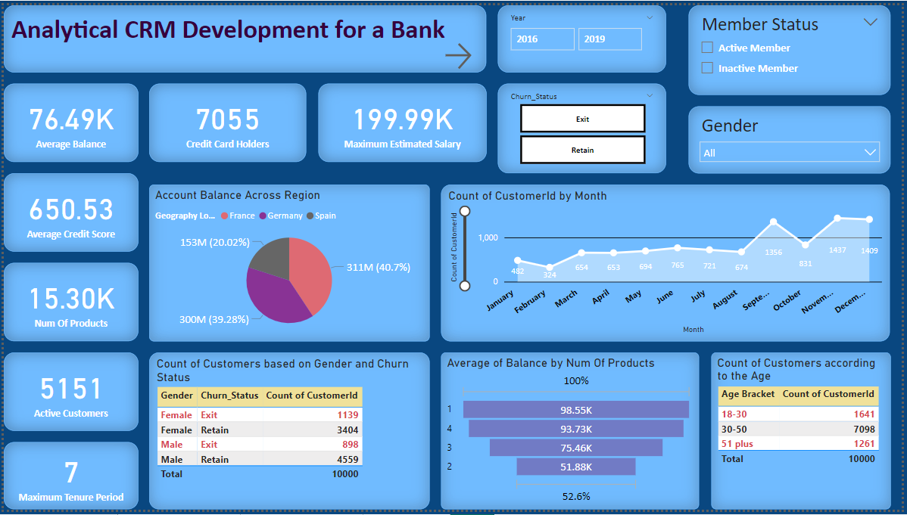
DASHBOARD
This is the report, I have created to analyze Customer Relationship Management

Slide 18
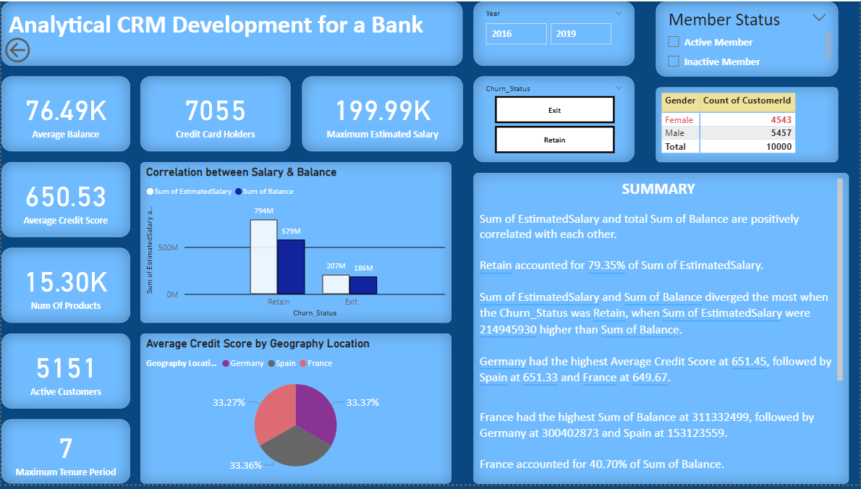
DASHBOARD - 2

Slide 19
THANK YOU

